Slide 1
Key Assumptions of the MAS 9th Outlook
Mohd Shah Hambali Arifin
26 December 2023

Slide 2
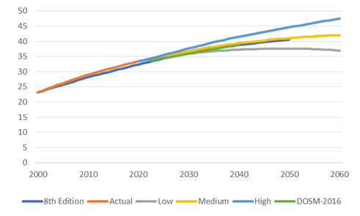
Macroeconomics
Population | UNDESA “Medium” | Reference
 | Population projections follow the medium pathway from UN DESA, which show slowing growth through 2060 | DOSM Malaysia UNDESA
Annual growth rate Population | ~0.54% growth since 2000 0.8% (estimated annual growth rate released in 2019 by DOSM, with the latest estimated population in 2022 as a base year) 0.82% – 0.57% for 2040 – 2050 | DOSM CEIC
Urbanization rate | 75% in 2020 85% by 2040 | NETR
GDP | 8.7% in 2022 (actual) 4.5% – 5.5% for the medium term (2023 – 2030) 4.5% - 2% in 2050 Avg GDP growth p.a (2016-2050) – 3.5% | DOSM 12th MP World bank The World in 2050 report by PWC
Note: CEIC: Global Economic Data, Indicators, Charts & Forecasts.
Notes:
Malaysia is categorized as upper-middle income
Expected to achieve the status of high-income nation within 2025 – 2030
In 2020, service activity contributed 59% of GDP, manufacturing 22%, mining and quaries 7%, agriculture 7% and construction at 5%.
The Government of Malaysia’s long-run and medium-run growth strategies are outlined in its Shared Prosperity Vision (SPV) 2030 and 12th Malaysia Plan (respectively).
The SPV and Malaysia plan go beyond high-income status, also ensuring growth is both sustainable and equitable. Currently Malaysia is categories as upper-middle income economy.
The 2019 SPV sets out “a commitment to make Malaysia a nation that achieves sustainable growth along with fair and equitable distribution.” 2 The SPV blueprint proposes targets across key growth areas: regional
inclusion, the role of SMEs, human capital, labor market and workers’ compensation, and social capital and well-being.
GDP is the sum of spending in a country by consumers, investors, and the government, plus net exports. High GDP growth is associated with low unemployment, because a growing economy demands a growing labor force. There are also inflationary pressures, but responsible monetary and fiscal policy can keep the inflation rate low.

Slide 3
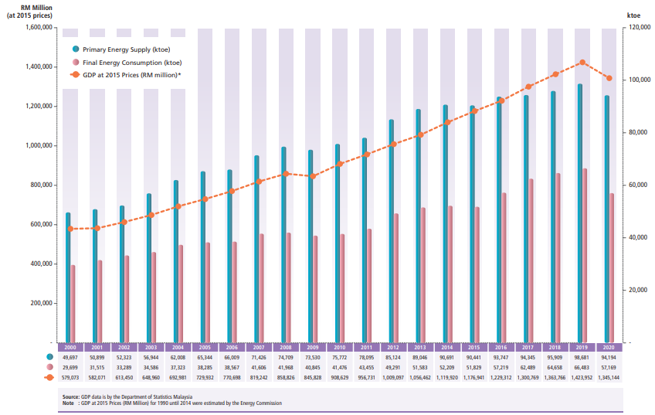
National Energy Balance
Trends in GDP, Primary Energy Supply and Final Energy Consumption
Source: NEB, EC 2023
Notes:
Decline in 2020 is due to pandemic covid 19, GDP contracted 5.6%
- TPES reduced 9.6%, similarly TFEC also reduced significantly.
2021 trend normalize as economic avtivity are back to BAU
Malaysia is developing country, the growth of GDP, TPES and TFEC is expected parallely grow till reach its saturation in future.

Slide 4
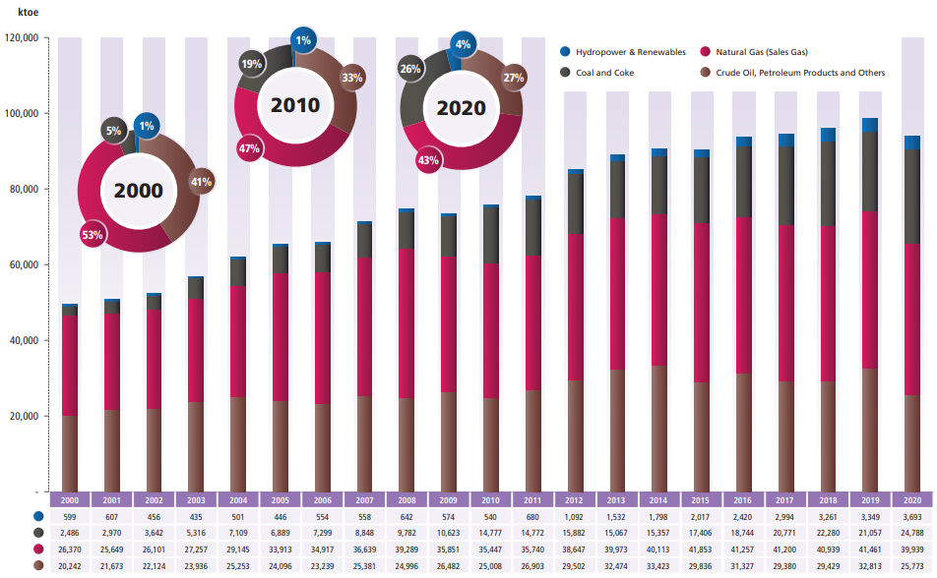
National Energy Balance
2020 Primary Energy Supply - Resources
Item/Share | Unit (ktoe/%)
2020 Total Primary Energy Supply | 94,193
Crude Oil & Petroleum Products | 27.4
Natural Gas | 42.4
Coal and Coke | 26.3
Hydropower & Renewables | 3.9
69.6% Indigenous | 30.4% Imported
Net Export (ktoe) |  |  |  | Net Import (ktoe)
Oil | LNG | NG | Elec | Pet. | Coal
3,635 | 23,216 | (4,340) | 298 | 1,997 | 22,235
Oil – Crude Oil
Pet. – Petroleum Products
Coal - Coal and Coke
Source: NEB, EC 2023
Notes:
Fossil fuels remain dominant, there is transition of major supply from coal to NG as Malaysia transition to cleaner energy
In terms of energy security, Malaysia sets a target of less than 40% imported resources.
Primary energy supply is defined as energy production plus energy imports, minus energy exports, minus international bunkers, then plus or minus stock changes.
Primary energy supply = Energy Production + Energy Imports – Energy Exports – International Bunkers +- stock changes
ST definition : TPES = Primary production + imports
Total primary energy supply (TPES) reduced by 4.6% (2018: 2.8%) compared to the previous year, and this is an obvious trend to be expected during a crisis of sorts. All of the fuel types recorded a decline, which contributed to the overall decline of the TPES. Total imports of energy were reduced by 9.6% from the previous year. Natural gas is the leading fuel used in TPES with its share of 42.4%, followed by crude oil, petroleum products, and others at 27.3%, coal, and coke at 26.3%, and renewable energy (RE) at 3.9%.

Slide 5
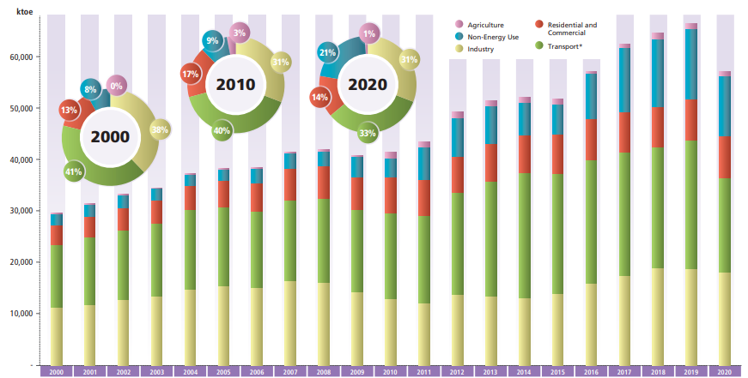
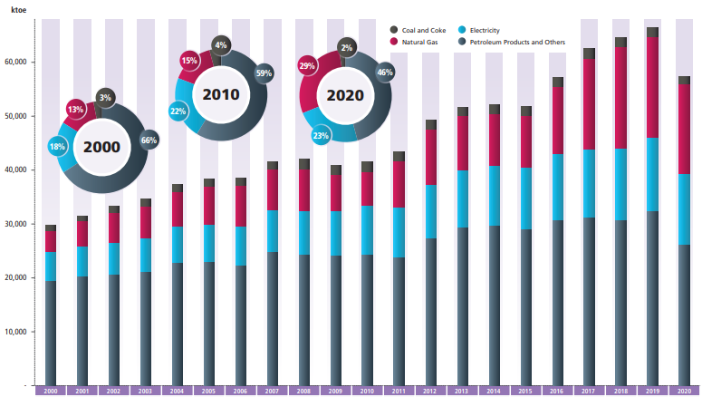
National Energy Balance
Total Final Energy Consumption – 57,169ktoe
by Sectors
by Fuel Type
The transport, power, and industry sectors represent the largest components of energy demand and collectively constitute approximately 75% of the total final energy demand.
Growing at a rate of 4% per annum.
The highest consumption by fuel type is petroleum products, 45% ~ transportation
Source: NEB, EC 2023
Notes:
Similarly, total final energy consumption (TFEC) also reduced significantly by 14.0% (2019: 2.8%), from 66,483 ktoe to 57,169 ktoe. The COVID-19 pandemic impacted the economy severely, affecting the demand for energy. Business closures during the lockdown period have driven the energy demand down substantially. The transport sector posted a huge reduction of 25.4% due to the travel ban during the lockdown period. This reduction is also shown by a huge drop in petrol and diesel consumption on the road, 19.0% and 19.5% respectively. The commercial sector and industry sector’s final energy consumption was reduced by 13.4% and 6.4%, respectively, due to the lockdown period that refrained businesses and industries from operating as usual. Only the residential sector posted a positive growth in its final energy consumption, partly due to Work-From-Home (WFH) measures taken by most employers in Malaysia in 2020 as a way of curbing the virus spread.
Non-energy use – comprised primarily of the feedstock of the petrochemical industry and has been the largest driver of energy demand growth at 15% per annum
Final energy demand is expected to grow, albeit at a lower pace
Lower correlations are typically observed between energy demand growth and GDP growth as economies mature and evolve from manufacturing-focused to service-based economies
Enhanced demand-side management and energy efficiency will also reduce the intensity of final energy demand across various sectors.

Slide 6
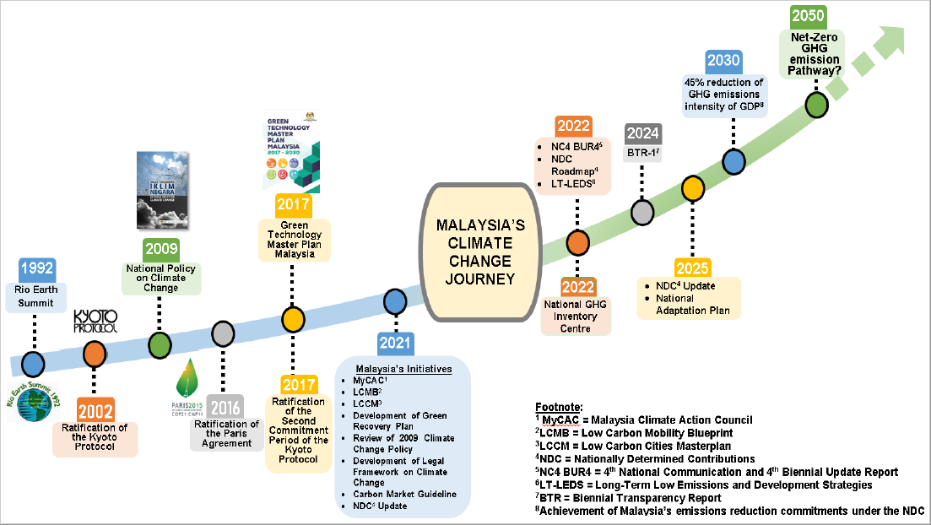
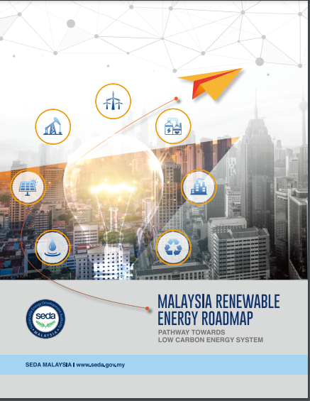
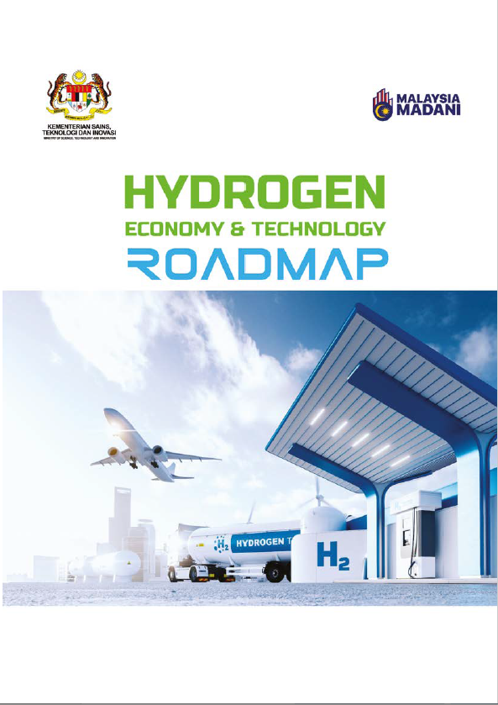



Climate Change Policies and Guiding Documents
2021
2023
2023
2023
2023
NETR’s
2050
2040
NEP
LCNA 2040

Slide 7
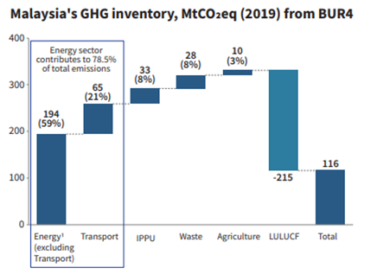
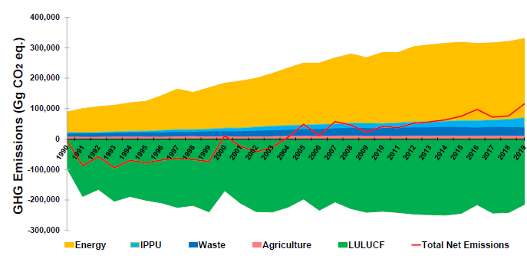
National Determined Contribution (NDC) and GHG Emissions
Malaysia sets an unconditional target of a 45% reduction in economy-wide carbon intensity against GDP compared to 2005 levels, to be achieved in 2030 (revised in 2021).
As of 2019, Malaysia's carbon emission is at 116MtCO2 equivalent, which is less than 1% of global emissions.
GHG Emission Time Series
A
Over time, Malaysia’s priority is to reduce emissions (A) and increase removals (B)
B
Net-Zero in 2050:
A+B = 0
IPPU – Industrial processes and product use
LULUCF – land use, land-use change and forestry
Source: Malaysia NDC
Notes:
In the 1st NDC, Malaysia committed to reducing its GHG emissions intensity against GDP by 35% unconditionally and a further 10% conditional upon receipt of climate finance, technology transfer, and capacity building from developed countries by 2030 compared to 2005 levels.
Malaysia’s NDC is economy-wide and will strive to include all key categories of anthropogenic emissions and removals.
LULUCF Categories:
Forest land Cropland Grassland Wetland Settlement
(Emissions and removals from grassland and wetland will be accounted for subject to the activities undertaken).
LULUCF pools:
Above ground Below ground
Soil organic carbon (drained peatlands)

Slide 8
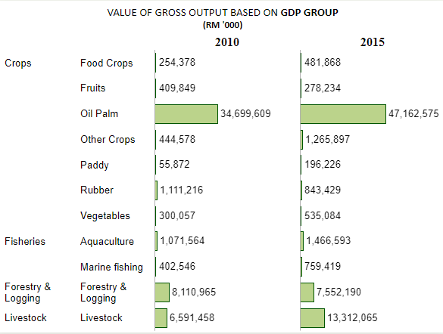
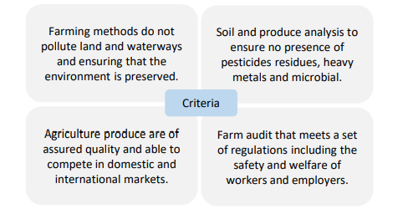
Agriculture (including fishery)
Energy demand grows organically based on historical trends, including the replacement of petroleum and diesel with biodiesel, particularly for plantation machinery and fishery.
Energy efficiency, fuel efficiency, and fuel switching trends continue.
The agri-food industry aims to reduce GHG emissions and continue the development of agrifood while maintaining and strengthening the conservation of forestry and biodiversity^{GTMP}.
Reduction of electricity intensity. From 1.5% in 2014 to 10% in 2025 and 15% in 2030.
Malaysian standard MS1529:2015, certification to recognize good agricultural practices and organic farming – Malaysia Good Agriculture Practices (MyGAP).
Overall, increase production efficiency/ optimization of energy consumption while maintaining the positive projection of the agri-food sector.
Source: Department of Statistics Malaysia
Agriculture sector contributes 8.9% of Malaysia’s GDP in 2022 (DOSM) | GDP Annual growth rate 2.9 – 3.3% | Agricultural exports increased from RM115.5 billion in 2019 to RM118.6 billion in 2020
Source:
Green Technology Masterplan 2017-2030
Green Practices Guideline for Agriculture Sector (2022) National Agrofood Policy 2021-2030
Green Practice Guideline Agriculture Sector
Notes:
Malaysia Organic Scheme or Malaysia Organic (MyOrganic) is a certification that recognizes farms that practice good agricultural
Output : 253 have been certified with MyOrganic Certification with an area of 2.045,60
Food crops grown in Malaysia such as durian, rice, cocoa, bananas, coconuts and pineapple

Slide 9
Agriculture (including fishery) – Scope of EE & RE
Energy Data Strategies (EEA1)
Energy Saving Strategies (EEA2)
Renewable Energy Strategies (EEA3)
Eco-Labelling Strategies (EEA4)
Data collection on direct and indirect energy usage in agricultural production. Dedicated approaches such as LCA to access potential impacts across different product chain.
Adopt energy-saving measures and prioritize supply from energy-producing facilities that use renewable sources. Develop a management plan to improve energy mix.
Adopt and increase the use of renewable energy.
Establish agriculture-specific eco-labelling initiatives through internal incentives and funding support for farmers.
Green Practices Guideline for the Agriculture Sector
Source:
Green Technology Masterplan 2017-2030
Green Practices Guideline for Agriculture Sector (2022) National Agrofood Policy 2021-2030
Green Practice Guideline Agriculture Sector

Slide 10

Buildings
General information.
Type | Industrial | Commercial | Residential
Electricity Consumption | 38% | 37% | 25%
Weighted average electrical energy price | 0.369kWh | 0.464kWh | 0.330kWh
Residential.
1. Typical load apportioning for residential buildings in Malaysia.
AC ownership and plug load increase due to the average household purchase power increase. Other categories remain unchanged.
Year | 2018 | 2020 | 2025 | 2030 | 2035
With AC | 60% | 65% | 85% | 95% | 95%
Without AC | 40% | 35% | 15% | 5% | 5%
Plug-load increase vs. base year | - | 15% | 25% | 30% | 30%
Assumption by EC, Malaysia
Source: Energy Commission, Malaysia

Slide 11
Buildings
Assumptions
Reference | Target
Consumption of electricity in all sectors is expected to steadily increase (moderately due to stringent MEPS requirements and the introduction of new technology) in parallel with the GDP. LPG demand for cooking grows organically based on historical trends, while natural gas demand is stagnant due to fuel switching to electricity or LPG. The growth of electricity demand takes into consideration the energy savings from the full enforcement of the Energy Efficiency and Conservation Act. The initial target is the reduction of electricity consumption of 8% by 2030. Total energy savings by 2035 is 1,447 million GJ (401,944 GWh = 401.9 TWh). Increase the number of green buildings from 550 in 2020 to 1,750 in 2030. | More fuel switching from LPG and natural gas to electricity, especially for cooking and water boilers at commercial premises. Electricity demand grows higher than REF and remains the primary energy for buildings. The LCNA 2040 proposes the target for the residential sector to achieve energy efficiency savings of 10% by 2040 compared to the business-as-usual scenario (2018 level). The RT 2050 targeted 20% energy efficiency savings by 2050 compared to the 2019 level.
Recent development
Increased digital infrastructure expenditure for data centers (20% from 2021 to 2026). Expected to reach 1358MW by 2029.
2022 | 46 Data Centres | 168 megawatts | 21 Providers
Source:
Energy Commission, Malaysia
National Energy Transition Roadmap (NETR)

Slide 12
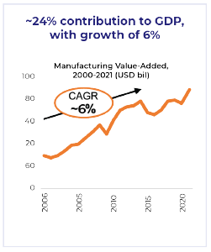
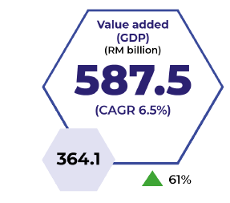
Industry
1. General
Fossil fuels remain dominant, with higher demand growth from 2023 to 2040.
Coal demand grows organically but takes consideration of the existing 50%-60% unutilized capacity in the cement industry.
Fuel switching from coal to biomass and waste in the cement industry.
Petroleum products demand grows slowly.
Growth of local SMEs to adopt green practices (95% SMEs and 5% large enterprises).
2020 | 2025 | 2030
800 Companies | 1,200 companies | 2,000 companies
2. Government policies that target energy efficiency improvements
Biofuel Program B7 (palm biodiesel) has been mandatory for industrial applications
Mandatory audits for large industrial buildings starting 2024
LCNA 2040
EE savings of 11% by 2040 compared to the BAU scenario (2018 levels)
RT 2050
23% EE savings by 2050
Reduction in carbon emission intensity based on NDC goals
3. Are any industry subsectors projected to grow/decline significantly?
Government's commitment to support the development and growth of the local EV sector.
EVs and hybrids account for new car sales: 20% by 2030, 50% by 2040 and 80% by 2050.
Proton will introduce and manufacture EVs in 2025.
Perodua aims for up to 20-30% of electric and hybrid vehicle sales by 2030.
2030
Source:
Energy Commission, Malaysia
New Industrial Master Plan (NIMP) 2030
National Energy Transition Roadmap (NETR)
2021
Notes:
Malaysia is a producer for materials related to EV battery manufacturing – not only does the country have reputable local companies that are equipped factory automation lines for battery cells and battery packs production which can support EV battery manufacturing activities; it also possesses a comprehensive E&E ecosystem, particularly for front-end to back-end semiconductor manufacturing activities.
The country continues to be an attractive base for global automotive manufacturers, where Honda, Toyota, Nissan, Mercedes-Benz, and BMW are just some of the global automotive giants which have set up their operations to take advantage of buoyant consumer demand.
The country continues to be an attractive base for global automotive manufacturers, where Honda, Toyota, Nissan, Mercedes-Benz, and BMW are just some of the global automotive giants which have set up their operations to take advantage of buoyant consumer demand.

Slide 13
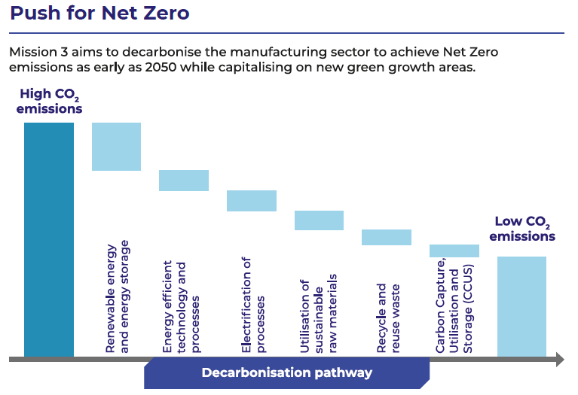
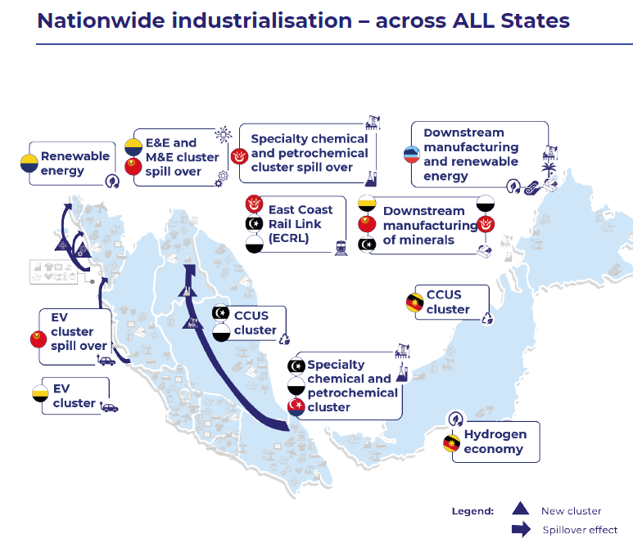
Industry
4. Any known plans for hydrogen and/or CCS (including timelines)?
New Industrial Master Plan (NIMP) 2030 target.
Grow carbon capture, utilization, and storage (CCUS) as a new sector.
No specific target and timeline for both areas.
Source:
Energy Commission, Malaysia
New Industrial Master Plan (NIMP) 2030
National Energy Transition Roadmap (NETR)
Notes:
REF - Reduction in economy-wide energy intensity consistent with regional targets.
ASEAN Regional Target: 32%; by 2025 from 2005 levels
APEC Regional Target: 45%; by 2035 from 2005 levels

Slide 14
Buildings
3. Government policies that target energy efficiency improvements in
the public or private sector.
NETR’s key initiatives for commercial buildings
Improve existing MEPS and 5-star rating bands.
Enhance mandatory audits for large commercial and industrial buildings.
Establish green building codes for energy-intensive residential and commercial buildings.
Launch a major EE retrofit initiative amongst government buildings.
Commercial.
1. Typical load apportioning for commercial buildings in Malaysia.
4. Typical Energy Saving Measures for Commercial Buildings in Malaysia
Implementation of Energy Saving Measures (ESM) | Percentage Savings (%)
Air Cond System / Chiller / AHU (Installation high efficient unit only) | 19.3
Awareness Program | 3.4
Compressor System (Installation high efficient unit only) | 0.3
Fan System (Installation high efficient unit only) | 0.5
Inverter / VSD / VFD | 2.0
Lighting (Installation high efficient unit only) | 18.08
Motor (Installation high efficient unit only) | 0.12
Operational control | 41.8
Others | 13.0
Process | 1.1
Pump System (Installation high efficient unit only) | 0.4
Source: Tenaga Nasional Berhad (TNB)
2. What is the share of public buildings in the commercial sector?
Commercial building electricity consumption by percentage
PBO | SCX | HTL | SHP | SAP | HEA | GOV | OTH
10% | 17% | 4% | 47% | 9% | 4% | 3% | 6%
Notes: Purpose Built Offices (PBO), Shopping Complexes (SPX), Hotels (HTL),
Shopping Lots (SHP) Services Apartments (SAP), Health (HA), Government (GOV)
and Other (OTH).
Source: NAPIC (PBO,SCX, HTL, SHP, SAP) and MYSPATA (HEA,GOV) baseline GFA data
Source: EACG RMK11

Slide 15
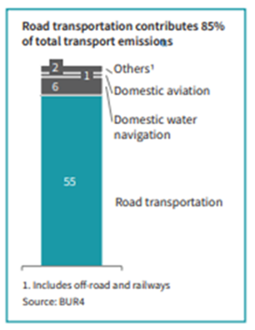
Transport
General Input
a) Prominent GHG emissions in Malaysia are driven by ICE vehicles.
b) Land transport is a key emitter (85%) of total emissions.
c) Increase in population in travel needs 2010 (40 trips) – 2030 (131 million trips), 69% increment, and the trend is expected to increase gradually.
d) Increase in vehicle TIV (Car 46%, Motorcycle 46%, Taxi 0.4%, Hire & Drive Car 0.3%, Buses 0.2%, Goods Vehicle 4% and other 3 %). Total number of Vehicles 2023 – 26.3 Million
e) Percentage of Vehicle Kilometre Travelled petrol cars (50%), goods vehicles (6.4%), motorcycles (41.3%) and others (2.3%).
f) Transport sector Final Energy Consumption (FEC). Road transport dominates, accounting for more than 90% of energy consumption.
g) Transport sector Greenhouse Gas (GHG) emission. 87.9% originated from road transportation, 10.2% from water-borne navigation, 1.9% from aviation, and 0.1% from railways.
h) Public Transport Electrification - involves electrification of first and last-mile public transport and upgrading infrastructure and electrical lines at bus depots for charging by 2030.
Source:
Low Carbon Mobility Blueprint
National Energy Transition Roadmap (NETR)
Notes:
TIV – Total Industry Volume

Slide 16
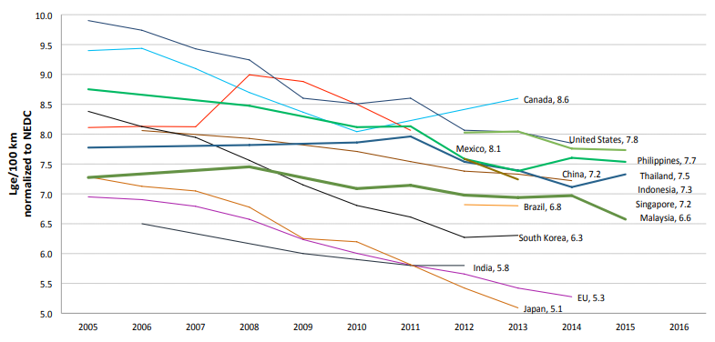
Transport - Reference
Gasoline and diesel remain as the dominant fuels.
Fuel efficiency target (7.2L of gasoline/100km) : Malaysia achieved 6.6 in 2015, maintaining the historical rate of 1%/year – ASEAN GFEI.
EEV dominate the light-duty vehicle sales.
Medium rate growth for EV penetration.
Notes:
Global Fuel Economy Initiative: GFEI
Malaysian cars consume on average on 6.6 LGe/100km, new cars in the Philippines consume around 17% more, with an average fuel consumption of more than 7.7 LGe/100km. This might be linked due to the fact that Malaysian per capita GDP is about three times higher than in the Philippines, allowing consumers to buy more expensive and hence more modern and more efficient cars.
Malaysia provide tax incentives for the domestic production of fuel-efficient cars but not for consumers. These schemes are geared primarily towards industry development, rather than the objective of reducing fuel consumption.
No fuel taxes implemented in Malaysia

Slide 17
Transport – Ref and TGT
Sector/ Areas | Year
 | 2020 (Base) | 2025 | 2030 | 2040 | 2050
Land: Public Transport | 40% (Greater KL) 20% (other cities) Status 2022 20 – 25% (Malaysia) | Introduction of B100 Acquirement of 150 electric buses and 3 bus depots Construction of 5 LRT3 stations. | 100% EEV for public transport 40% modal share (all cities) 1% of passengers shift from road to rail. Adopt cleaner energy for buses: E-bus 20%, and B100 for 30% of big bus. Adopt cleaner energy for taxi: diesel 0%, petrol 0%, NGV 0%, EV 20%, and ICE-EEV 80% | 50% modal share | 60% modal share
Land: Private Transport | 85% EEV 0.4% EV 2021 (Increase 39.5%) 2020 | 10% EV^{LCMB} Solar PV installation for rail operation (non-traction) | 100% EEV^{LCMB} Shift use motorbikes to e-bike (85%:15%) Electric motorcycles to reach 2.8 million by 2030. Shift use of conventional transition from PHEV to BEV. Electric car sales are to reach 200,000. 15% EV share of the Total Industry Volume (TIV) by 2030^{LCMB}. | 50% E2W share of fleet. 38% - 50% EV (4W) share of fleet | 80% E2W share of fleet. 80% EV (4W) share of fleet.
Source:
Low Carbon Mobility Blueprint
National Energy Transition Roadmap (NETR)
Notes:
The Electric Vehicle (EV) market in Malaysia is relatively small but growing rapidly. According to the Malaysian Automotive Association (MAA), 2,717 EVs were sold in 2021, a significant increase from the 1,642 units sold in 2020. The EV market share in Malaysia is still relatively low, accounting for only 0.4% of total vehicle sales. However, with the Government’s goal to have 125,000 EVs on the road by 2030, the market is expected to grow in the coming years.
To promote the growth of the EV sector in the country, Malaysia’s Ministry of Investment, Trade, and Industry (MITI) introduced the Battery Electric Vehicle Global Leaders Initiative (BEV GLI). The BEV program allows foreign companies to sell cars in Malaysia without Approved Permit (AP) rules, thus making imported vehicles cheaper. This initiative aims to help boost EV demand in the local market and further promote the development of the ecosystem to support BEV adoption.

Slide 18
Transport – REF and TGT
Sector/ Areas | Year
 | 2020 (Base) | 2025 | 2030 | 2040 | 2050
Fuel Efficiency Target | National target of 144g CO2/km (equivalent to 6.2L/100km) for passenger vehicles | National target of 123g CO2/km (equivalent to 5.3L/100km) for passenger Inline with ASEAN | National target of 95g CO2/km (equivalent to 4.1L/100km) for passenger vehicles | NA | 3.3 LGe/100km by 2050 (GFEI 2017) Ambitious target
Charging stations | NA 1500 (2022) | 10,000^{LCMB} Implement a battery swapping system. | Organic growth ~12,500 | Organic growth ~15,000 | Organic growth ~17,500
Heavy Transport | NA | NA | 1% road freight to rail | Alternative fuel standard for heavy transport (B30 by 2040) | ~30% light vehicle fuel economy ~24% heavy transport fuel economy Biofuel blending for heavy transport B30. 5% Hydrogen penetration
Marine | NA | NA | NA | LNG as an alternative fuel for marine transport (25% by 2040) | 40% green fuel penetration
Aviation | NA | NA | NA | NA | 47% SAF blending mandate. Adopt ICAO’s LTAG of net-zero carbon emissions.
EV Manufacturing | NA | NA | NA | NA | 90% local xEV manufacturing
Notes:
2025 - 10,000 units of Charging Facilities built by 2025 (comprising 9,000 alternating current (AC) units and 1,000 direct current (DC) units).
2050 LGe Target. Option 3: Based on the average of all LDV fuel consumption targets for the year 2020 around the world

Slide 19
POWER
REF
Share of coal-fired power generation is expected to ramp down over time.
Fossil fuel sources still dominate the national power landscape.
Gas is expected to act as a lower-carbon transition fuel away from baseload coal.
TGT
No new coal-fired power plants for electricity generation, while existing coal-fired power plants will retire according to the Power Purchase Agreement (PPA) date (complete phase-out by 2045). Close to fully phased-out coal from the power generation mix.
Renewables and coal installed capacity in 2040 and 2050 will be based on the MyRER and NETR’s LCNA and RT targets.
Solar and hydro are dominating the growth in renewables.
Biomass clustering with a centralized plant using aggregated feedstock from multiple neighboring mills targeted to start in 2024, together with biomass co-firing.
Consideration of CCS/CCUS, biomass4, ammonia, and green hydrogen co-firing technology deployment in electricity generation.
2030 | 2040 | 2050
3 CCUS hubs. Up to 15 MTPA of CO₂ storage capacity. | 1 carbon capture hub. Up to 40 MTPA of CO₂ storage capacity. CCUS technology at a utilization rate of 50%^{ERIA} | 2 additional carbon capture hubs. Up to 40 – 80 MTPA of CO₂ storage capacity.
Source:
Energy Commission, Malaysia
National Energy Transition Roadmap (NETR)
ERIA

Slide 20
Electricity Demand Profile – Pending Data from Single Buyer

Slide 21
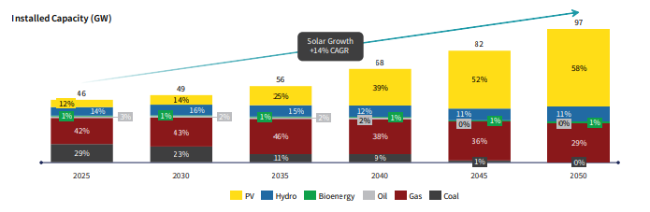
Installed Capacity and Generation Mix
Sector/ Areas |  | Year
 | 2020 | 2025 | 2030 | 2035 | 2040 LCNA | 2050 RT
Electricity Generation (renewable energy mix) | 20% RE mix (installed capacity)^{GTMP} | 23% RE mix (installed capacity)^{GTMP} 31% RE mix ^{MYRER} | 30% RE mix (installed capacity)^{GTMP} | 40% RE mix (installed capacity)^{MYRER} | 41% - 52% RE mix (installed capacity)^{NETR} | 70% RE mix (installed capacity)^{NETR}
Energy Efficiency | 8% reduction in electricity consumption ^{NEEAP} | 10% reduction in electricity consumption ^{GTMP} | 15% reduction in electricity consumption ^{GTMP} | NA | 21% reduction in electricity consumption ^{NETR} | 43% reduction in electricity consumption ^{NETR}
Source:
Energy Commission, Malaysia
Green Technology Masterplan (GTMP)
Malaysia Renewable Energy Roadmap (MyRER)
National Energy Transition Roadmap (NETR)

Slide 22
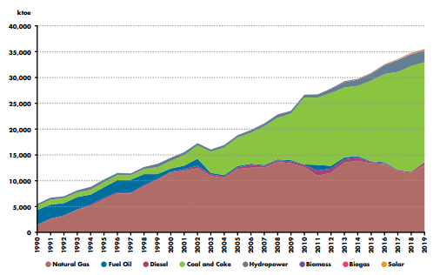
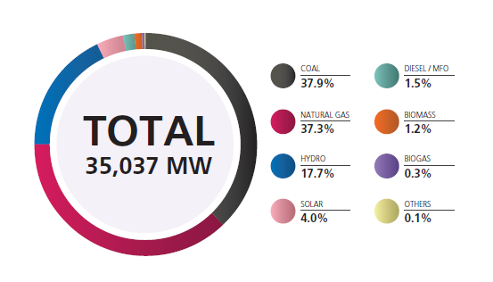
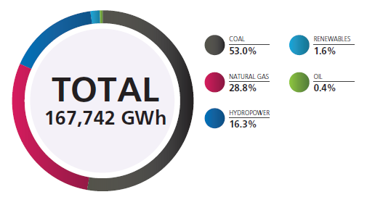
Installed Capacity and Generation Mix (1990 – 2020)
POWER
Installed Capacity (MW)
Historical Fuel Input to Power Station
Generation Mix by Fuel Type
Source:
Energy Commission, Malaysia
National Energy Transition Roadmap (NETR)
ERIA

Slide 23
Electricity

Slide 24
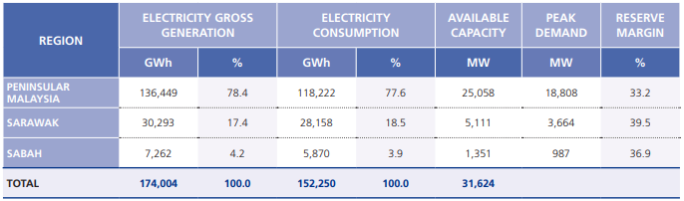
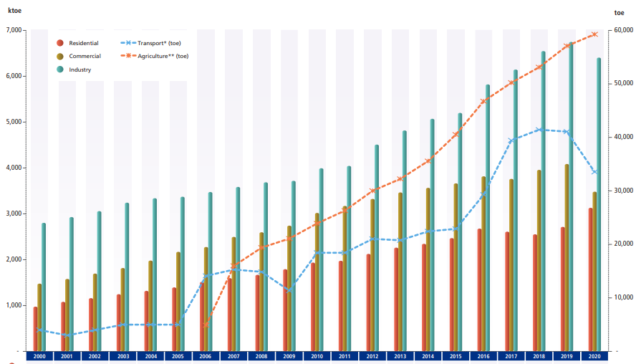
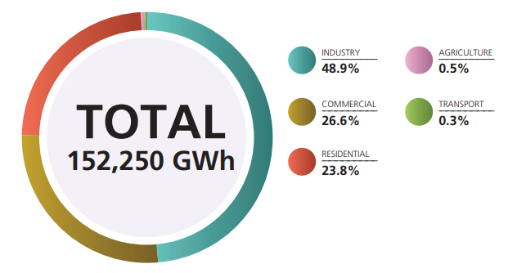
Electricity
Gross Generation, Consumption, Available Capacity, Peak Demand,
and Reserve Margin for Electricity in Malaysia
Approved Reserve Margin
2020-2024 | 28%
2025-2029 | 25%
2030-2034 | 23%
2035-2039 | 20%
Historical Electricity Consumption by Sectors in 2020
Electricity Consumption by Sectors in 2020

Slide 25
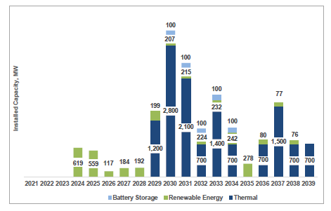
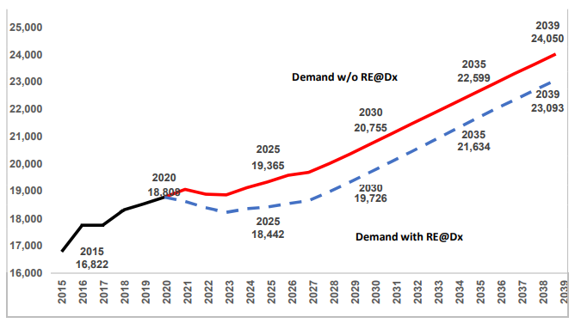
Malaysia’s generation development plan and future retiring plants
New Capacity Projection (MW)
Peak Demand Actual 2015-2020 and Projection 2021-2039
Complete list
Source:
Energy Commission, Malaysia
Report on Peninsular Malaysia Generation Development Plan 2021 - 2039

Slide 26
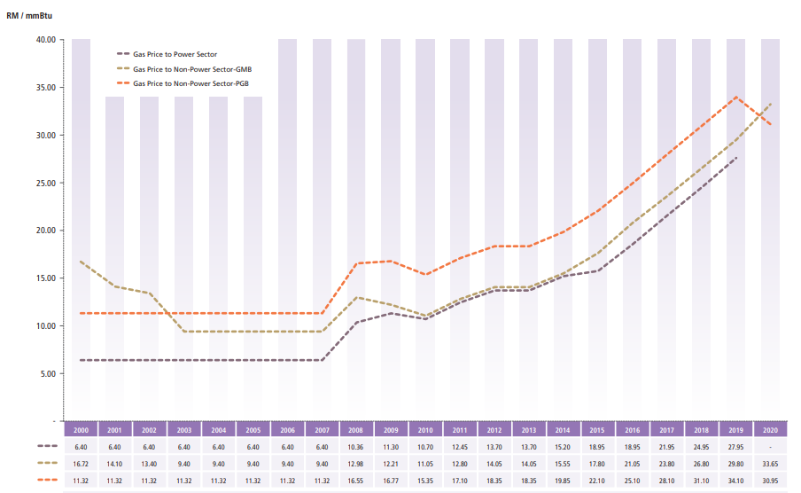
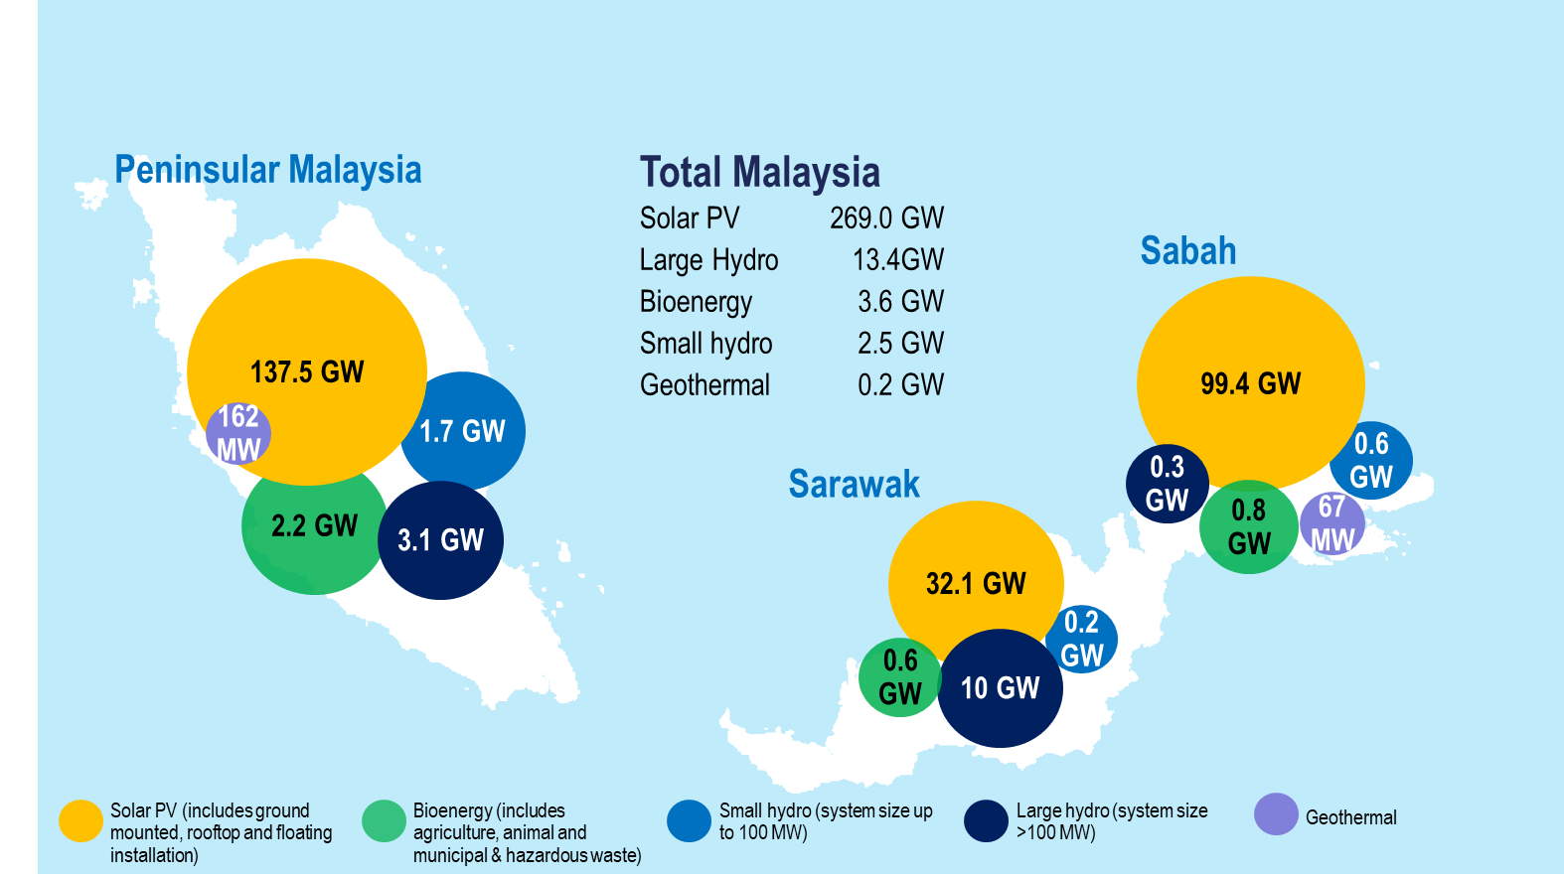
Fuel prices (coal, gas)
Average Annual Prices of
Source:
SEDA Malaysia
Report on Peninsular Malaysia Generation Development Plan 2021 - 2039

Slide 27
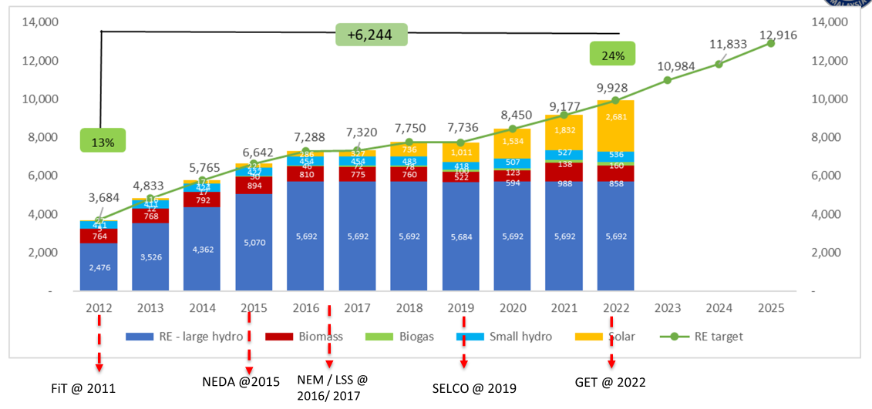
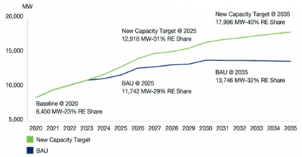
Renewable Energy
Sector/ Areas | Year | Year
 | 2020 | 2025 | 2030 | 2035 | 2040 | 2050
Electricity Generation (renewable energy mix) | 20% RE mix (installed capacity)^{GTMP} | 23% RE mix (installed capacity)^{GTMP} 31% RE mix ^{MYRER} | 30% RE mix (installed capacity)^{GTMP} | 40% RE mix (installed capacity)^{MYRER} | 41% - 52% RE mix (installed capacity)^{NETR} LCNA | 70% RE mix (installed capacity)^{NETR} RT
Year | Hydro Dam | Capacity (MW)
2027 | Kelantan (Nenggiri) | 300
2 | Pahang (Tekai) | 168
3 | Sabah (Upper Padas) | 180
4 | Sarawak (Baleh) | 1,295
Source:
SEDA Malaysia
Report on Peninsular Malaysia Generation Development Plan 2021 - 2039

Slide 28
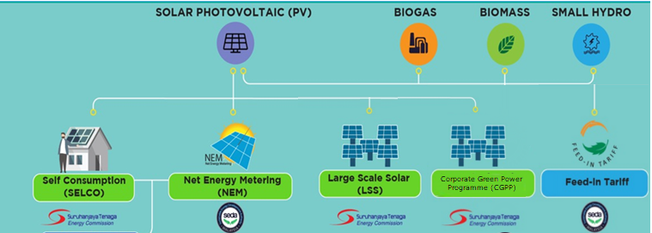
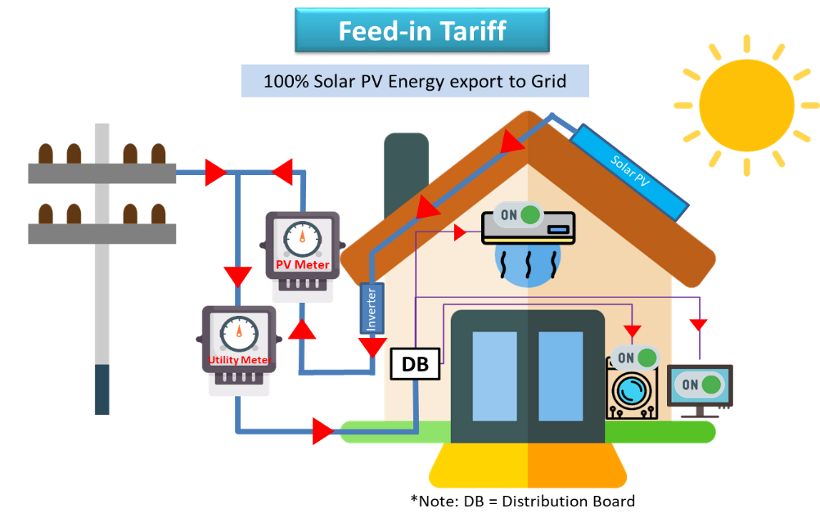
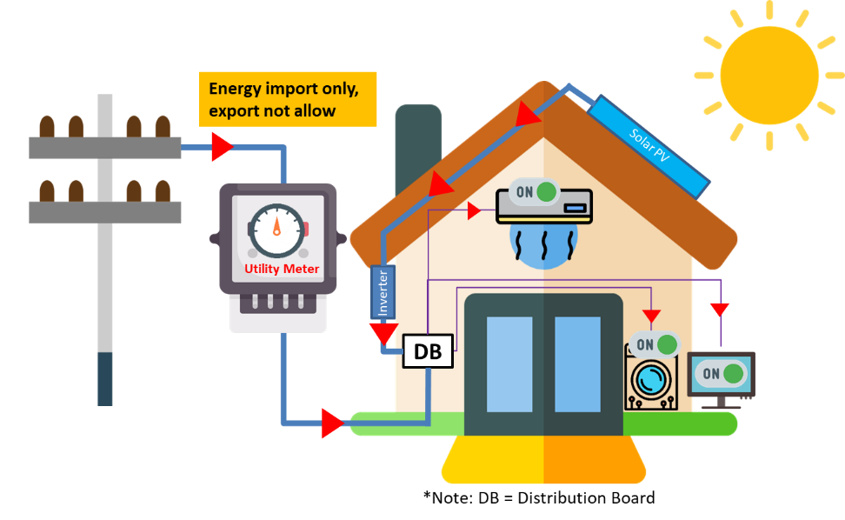
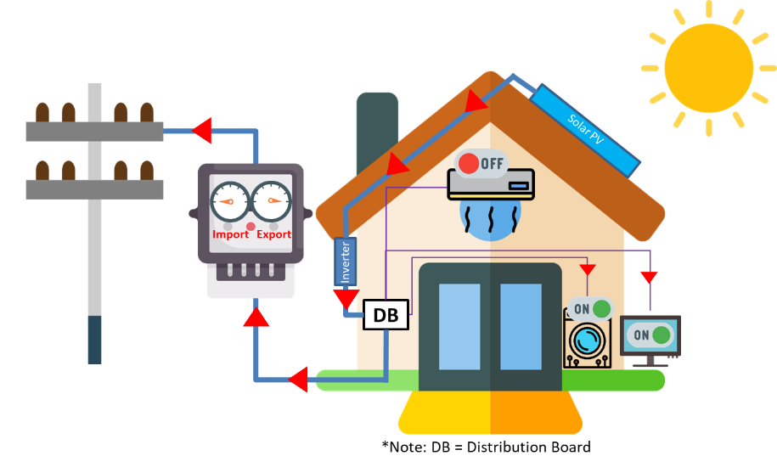

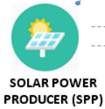
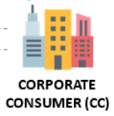
RENEWABLE ENERGY PROGRAM IN MALAYSIA
FiT & LSS
SELCO
NEM
CGPP
100% Solar PV energy export to Grid)
Solar PV energy for own use only
Solar PV energy (Own-used + Export to Grid)
Virtual sale of electricity

Slide 29
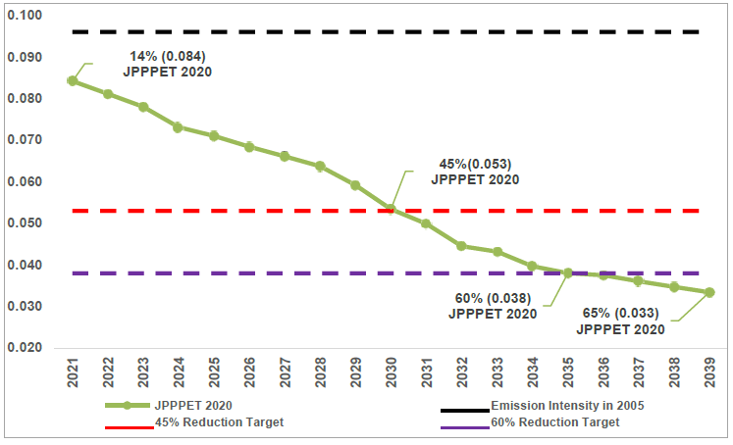
Emission Intensity Projection Target for Power Sector
Specific emission targets for the power sector?
Carbon Emission Intensity Projection
(2021 – 2039) for Malaysia’s Power Sector
Source:
Energy Commission, Malaysia
Report on Peninsular Malaysia Generation Development Plan 2021 - 2039

Slide 30
SUPPLY
General Input
For oil and natural gas supply,
The domestic oil and gas production limit continues until the resources are fully depleted.
LNG exports continue until the expiration of existing contracts.
CCS projects for Kasawari and Lang Lebah gas fields are expected to operate by 2026 and 2028, respectively.
For coal supply, dependency on imported coal for electricity generation and industry continues.
For renewables supply, fully rely on domestic production and consider the possibility of exporting green energy.
For hydrogen supply, fully rely on domestic supply production.

Slide 31
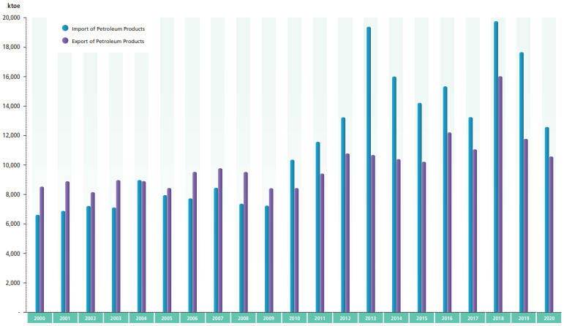
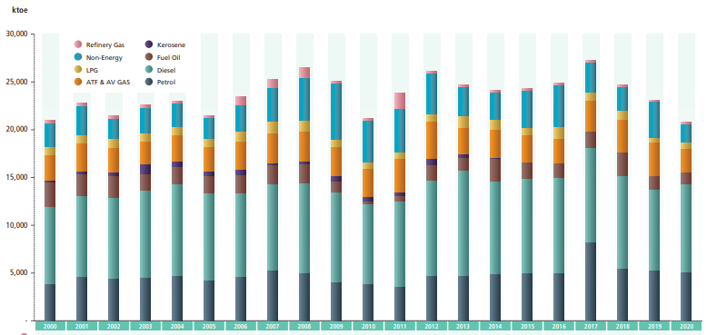
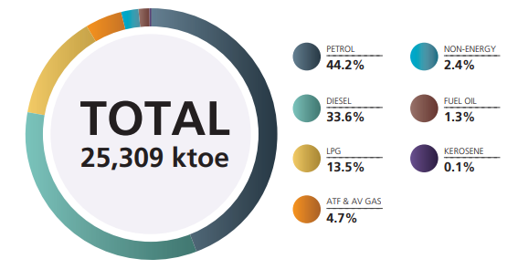
Oil
Export and Import of Petroleum Products
Production of Petroleum Products from Refineries
Oil Consumption by Sectors
Source:
Energy Commission, Malaysia

Slide 32
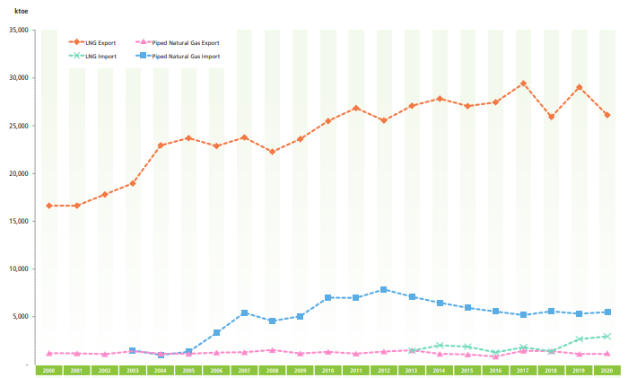
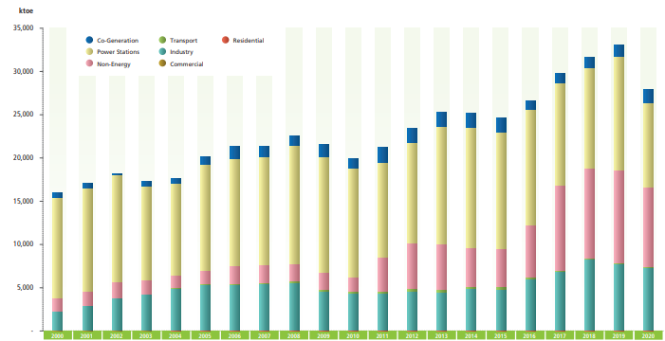
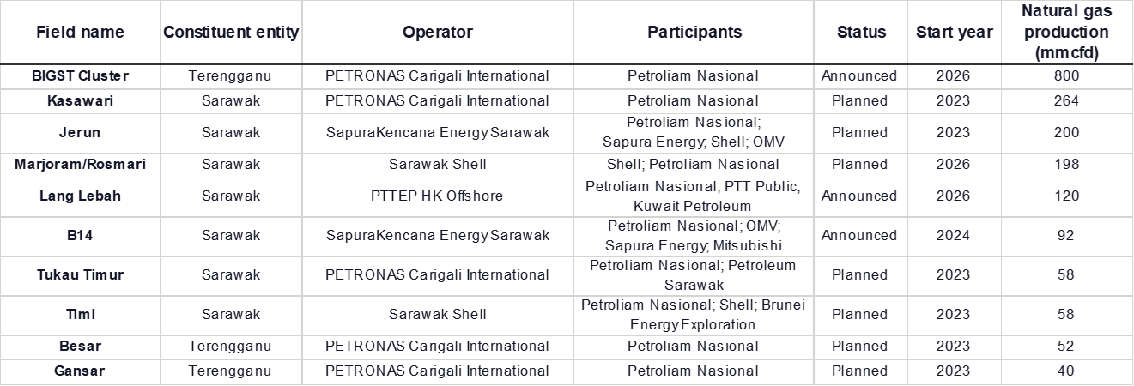
Natural Gas and LNG
Export and Import of Piped Natural Gas and LNG
Natural Gas and LNG Consumption by Sectors
Source:
Energy Commission, Malaysia

Slide 33
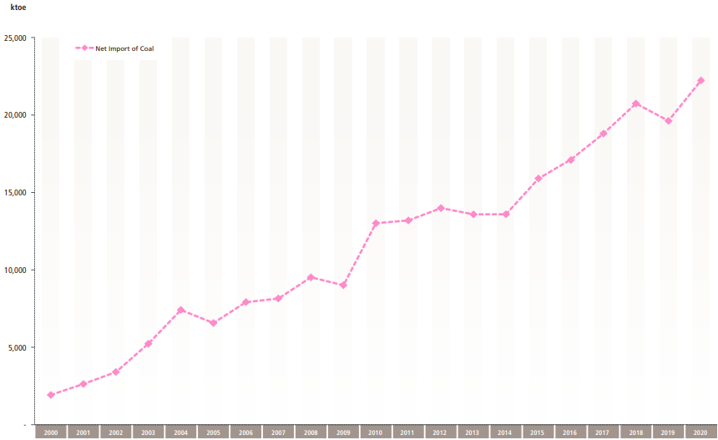
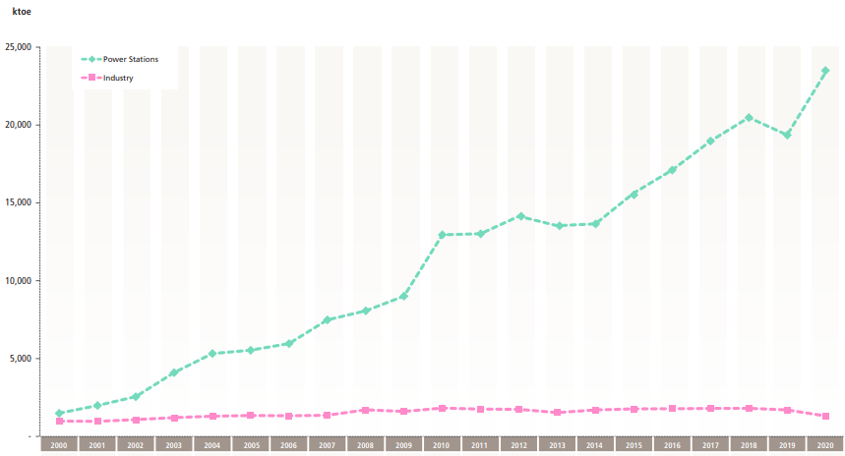
Coal
Net Import of Coal
Coal Consumption by Sectors
Source:
Energy Commission, Malaysia

Slide 34
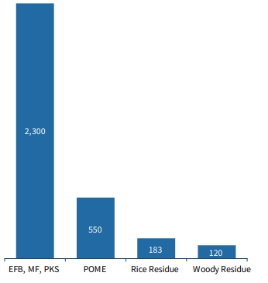
Nuclear
Although Malaysia has established a nuclear agency and has periodically reviewed the nuclear option, as of 2023, there are no nuclear power generation plants, and plans for a nuclear plant are at the feasibility stage.
Bioenergy
Steady growth of biofuel (biodiesel) – ambitious target:
2030 | 2040 | 2050
0.6 billion litres of biofuel production ~500MW of bioenergy installed capacity | 1.8 billion litres of biofuel production ~600MW of bioenergy installed capacity | 3.5 billion litres of biofuel production ~1,400MW of bioenergy installed capacity
Bioenergy Generation Potential
in Malaysia (GW)^{MYRER}
Source: Various PDOE Reports

Slide 35
Malaysia Hydrogen Economy
NETR LCNA proposes the following targets:
Blue Hydrogen: To completely phase out the use of grey hydrogen as a feedstock by 2050.
Green Hydrogen: To produce up to 2.5 Mtpa of green hydrogen by 2050 from RE, such as hydroelectric power and solar.
Low-carbon Hydrogen Hubs: To establish one low-carbon hydrogen hub by 2030 and an additional two hubs by 2050, bringing the total to three hubs.
2030 | 2040 | 2050
Establishment of 1 hydrogen hub | Establishment of 2 hydrogen hubs | Up to 2.5MTPA local green H₂ production
ASPECT | DETAILS
Policy | Hydrogen Economy and Technology Roadmap (HETR) 2023
National Target | 2.5 MTPA by 2050 – NETR’s RT Scenario 7 MTPA by 2050 – HETR’s Ref Scenario 16 MTPA by 2050 – HETR’s Target Scenario
Industry Value Chain | Production of green hydrogen in Sarawak: 130kg per day Production of grey hydrogen - 1 MTPA
Achievement/ Progress | Sarawak Energy’s Integrated Hydrogen Production Plant and Refueling Station in Kuching, Sarawak in May 2019 with a production capacity of 130kg of Hydrogen per day. Gentari exports hydrogen to Japan in ammonia or metylcyclohexane (MCH) with a capacity of 50,000-ton H₂/year. SEDC has inked MoUs with a Japanese consortium (Sumitomo and ENEOS) that focuses on hydrogen export in the form of MCH.3,000-ton H₂/year for local consumption and 50,000-ton H₂/year for export SEDC has also inked MoU with a Korean consortium (Samsung, POSCO & Lotte Chemical) that focuses on hydrogen export in the form of ammonia. 7000ton/year of green hydrogen for Sarawak’s local use (metro public transport). 600,000 ton/year of blue ammonia and 630,000 of green ammonia. 460,000 ton/year of green methanol.
Source:
NETR
HETR

Slide 36


Summary TGT Scenario
Low Carbon Nation Aspiration (2040)
Responsible Transition
(2050)
RT Pathway 2050 is the best-fit scenario developed in consideration of current technology developments, global trends and national circumstances
Total Primary Energy Supply (Mtoe), by energy source
Starting point
(2023)
Low Carbon Nation Aspiration (2040)
Responsible Transition (2050)
Responsible Transition (RT) Pathway 2050
117
95
20 (17%)
102
The RT pathway aims to:
4 (4%)
5 (5%)
18 (18%)
20 (17%)
18 (17%)
increase RE
Increased use of RE in the power generation mix
phase out coal
Close to fully phased-out coal from the power generation mix
pursue EE
Broad based energy efficiency initiatives pursued
expedite green mobility
Shift to electrification and biofuels expedited in the transport sector
1 (1%)
41 (43%)
46 (39%)
57 (56%)
33 (35%)
31 (27%)
21 (21%)
2023
2040
2050
Renewables for hydrogen
Renewables¹
Coal
Natural gas
Crude oil, petroleum products and others
1 includes bioenergy, solar, hydropower and hydrogen
Open

Slide 37
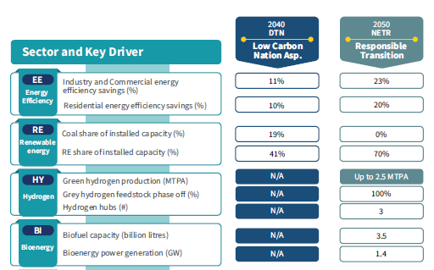
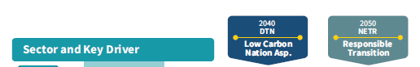
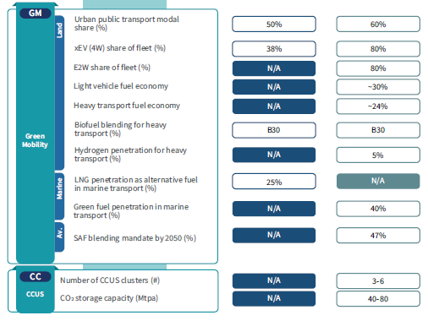
Summary TGT Scenario
Target across NEP and NETR’s energy transition levers
Open

Slide 38












Levers
Flagship Catalyst Projects and Initiatives
The catalyst projects and initiatives champions will showcase varying modalities in accelerating Malaysia's energy transition journey
EE
EFFICIENT SWITCH
H₂
HYDROGEN FOR POWER
Energy Efficiency and Conservation Act
Energy Audit for Rail Sector
Co-firing of Hydrogen and Ammonia
NRECC
MOT
TNB
H₂
RE
RENEWABLE ENERGY ZONE
Bio
BIOMASS DEMAND CREATION
Integrated RE Zone
Solar Park
Hybrid Hydro-Floating Solar
Residential Solar
Biomass Clustering
Biomass Co-firing
Khazanah
TNB
TNB
Sime Darby Property
KPK, NRECC, SEDA
KPK, Malakoff
RE
ENERGY STORAGE
GMob
FUTURE MOBILITY
Energy Storage System
EV Charging Stations
Mobile Hydrogen Re-fuelling Station
Public Transport Electrification
Solar PV Installation for Rail Operations
NRECC, ST
MITI
MOSTI
MOT, Prasarana
MOT
RE
ENERGY SECURE
GMob
FUTURE FUEL
Sabah Energy Security Initiative
Biofuels Hub
ECoS
PETRONAS
H₂
GREEN HYDROGEN
CCS
CCS FOR INDUSTRY
Sarawak Hydrogen Hub
Regulatory Framework
Kasawari and Lang Lebah CCS
SEDC Energy
KE
PETRONAS
CO₂
CO₂
Open

Slide 39

Levers
Key Initiatives and Enablers
Energy Efficiency
Renewable Energy
Hydrogen
RT Pathway 2050 Targets
Industry and Commercial EE savings
Residential EE savings
Coal share of installed capacity
RE share of installed capacity
Green H₂ production
Grey H₂ feedstock phase off
H₂ hubs
23%
20%
0%
70%
Up to 2.5 MTPA
100%
3 hubs
Key Initiatives
EE1 Improve EE awareness
EE2 Improve existing MEPS and 5-star rating bands
EE3 Enhance mandatory audits for large commercial and industrial buildings
EE4 Establish green building codes for energy-intensive residential and commercial buildings
EE5 Establish an ESCO platform
EE6 Launch a major EE retrofit initiative amongst government buildings
RE1 Establish solar parks for accelerated deployment of utility-scale solar
RE2 Promote floating solar and agrivoltaic technology
RE3 Expand virtual aggregation model for rooftop solar
RE4 Develop plan for accelerated investments of transmission and distribution
RE5 Develop TPA framework for sourcing of RE
RE6 Set up RE exchange hub to enable cross-border RE trading
HY1 Establish low-carbon hydrogen standards and regulations
HY2 Develop domestic green electrolyser manufacturing capabilities
HY3 Reduce Leveised Cost of Hydrogen (LCOH) for low-carbon hydrogen
HY4 Stimulate demand for low-carbon hydrogen
Key Initiatives 1 – 16
Open

Slide 40

Levers
Key Initiatives and Enablers
Bioenergy
Green Mobility
(Light Vehicle)
Green Mobility
(Heavy Vehicle)
RT Pathway 2050 Targets
Urban public transport modal share
xEV (4W) share of fleet
Biofuel blending for heavy transport
Biofuel capacity
Bioenergy power generation
Heavy transport fuel economy
60%
80%
3.5 billion litres
1.4 GW
~24%
B30
xEV (2W) share of fleet
Light vehicle fuel economy
80%
~30%
Key Initiatives
BI-1 Explore alternative bioenergy feedstock
BI-2 Enhance attractiveness of palm oil biomass
BI-3 Address challenge of supply security
BI-4 Catalyse local demand for bioenergy
BI-5 Improve solid waste management policies
GM-LV1 Drive public transport modal share shift to 40% by 2040 and 60% by 2050
GM-LV2 Improve light vehicle fuel economy
GM-LV3 Accelerate electrification of light vehicles segment (E4W)
GM-LV4 Accelerate electrification of light vehicles segment (E2W)
GM-HV1 Enhance demand-side management with fuel economy
GM-HV2 Implement B30 biodiesel blending mandate
GM-HV3 Introduce future powertrains for heavy vehicles
Key Initiatives 17 – 28
Open

Slide 41
Levers
Key Initiatives and Enablers
Green Mobility
(Aviation)
Green Mobility
(Marine)
CCUS
RT Pathway 2050 Targets
SAF blending mandate
Green fuel penetration in marine transport
CO₂ storage capacity
CCUS clusters
47%
40%
3 to 6 clusters
40 – 80 MTPA
Key Initiatives
GM-AV1 Establish overarching aviation decarbonization roadmap
GM-AV2 Implement SAF blending mandate
GM-AV3 Undertake palm oil-feedstock emissions study
GM-MA1 Unlock market opportunities of biofuel in marine bunkering
GM-MA2 Unlock market opportunities of future fuels in marine bunkering
CC1 Develop CCUS-specific policies and regulations
CC2 Strengthen CCUS adoption through provision of incentives across all relevant sectors and facilitate hub development
CC3 Facilitate CCUS hub infrastructure development
CC4 Establish transboundary CO₂ agreement
CC5 Promote local utilisation of CO₂ in industry
Key Initiatives 29 – 38
Open

Slide 42
Ambition
Projected GHG Emissions Reduction
Projected 32% reduction of GHG emissions for the energy sector from 261 MtCO2eq. (2019) to 175 MtCO2eq (2050)
Projected GHG Emissions,
2023-2050 (MtCO₂eq)
Projected GHG Emissions,
2050 (MtCO₂eq)
Critical to scale-up non-energy abatement to address expected emissions growth (as projected by LT-LEDS)
300
Increase cement clinker substitution
Increase steel scrap utilisation
Carbon capture
…
Shift waste from open landfills to WtE plants
Sanitary landfills
Recycling
…
Optimise or reduce fertiliser application
Alternate Wetting and Drying in rice fields
…
200
-32%
-12
100
0
-215
2019
2030
2040
2050
Energy
CCS
Energy with CCS
Others¹
LULUCF²
IPPU abatement
Waste abatement
Agriculture abatement
Note: Emissions pathway is estimated by multiplying primary fuel source in TPES to emissions factor by primary source. The emissions factor is sourced from the 2006 IPCC Guidelines for National Greenhouse Gas Inventories. The objective of this method is to provide directional guidance on policy decisions and is not intended as a submission to UNFCCC nor any other international bodies.
2050
2019
1. Includes IPPU (industrial processes and product use), waste and agriculture
2. LULUCF = land use, land-use change and forestry
Open

Slide 43
Thank you.
https://aperc.or.jp

Slide 44
Summary

Slide 45


Summary of Energy Flow Chart 2020

Slide 46
Malaysia’s generation development plan and future retiring plants
Year | Generation Capacity | Retiring Plants
2021 | Edra Energy (CCGT) (3x747 MW) RE (860 MW) | YTL Power (CCGT) (585 MW)
2022 | RE (652 MW) | TNB Pasir Gudang (CCGT) (275 MW) GB3 (CCGT) (640 MW)
2023 | RE (663 MW) | Panglima (CCGT) (720 MW)
2024 | TADMAX (CCGT) (2x600 MW) RE (855 MW) | SKS Prai CCGT (341 MW) TTPC (CCGT) (650 MW) TNB Gelugor (CCGT) (310 MW)
2025 | RE (818 MW) | TNB Putrajaya GT4 & GT5 (OCGT) (249 MW)
2026 | THB (CCGT) (2x600 MW) RE (117 MW) | KLPP (CCGT) (675 MW)
2027 | Nenggiri (Hydro) (300 MW) RE (184 MW) | Segari Energy Ventures (CCGT) (1,303 MW)
2028 | RE (192 MW) | TNB Tuanku Jaafar PD1 (CCGT) (703 MW)
2029 | CCGT (1x700 MW) CCGT (1x500MW) RE (199 MW) | KEV Gas U1 & U2 (Thermal Gas) (578 MW) KEV Coal U3-U6 (Coal) (1,474 MW)
2030 | CCGT (4x700 MW) RE (207 MW) BESS (1X100MW) | TNB Tuanku Jaafar PD2 (CCGT) (708 MW) TNB Janamanjung (Coal) (2,070 MW)
Note: CCGT = Combined Cycle Gas Turbine; OCGT = Open Cycle Gas Turbine.
BESS = Battery Energy Storage System
Source: Energy Commission, Malaysia

Slide 47
Malaysia’s generation development plan and future retiring plants
Year | Generation Capacity | Retiring Plants
2031 | CCGT (1x700 MW) Coal (2x700 MW) BESS (1x100 MW) RE (215 MW) | Tanjung Bin Power (Coal) (2,100 MW)
2032 | CCGT (1x700 MW) BESS (1x100 MW) RE (224 MW) | NA
2033 | CCGT (2x700 MW) BESS (1x100 MW) RE (232 MW) | Jimah Energy Venture (Coal) (1,400 MW)
2034 | Coal (1x700 MW) BESS (1x100 MW) RE (242 MW) | NA
2035 | RE (278 MW) | NA
2036 | CCGT (1x700 MW) RE (80 MW) | NA
2037 | CCGT (1x700 MW) Coal (1x700 MW) OCGT (1x100 MW) RE (77 MW) | TNB Prai (CCGT) (1,071 MW) TNB CBPS (CCGT) (375 MW)
2038 | CCGT (1x700 MW) RE (76 MW) | Pengerang Power (Co-Gen) (600 MW)
2039 | CCGT (1x700 MW) | NA
Source: Energy Commission, Malaysia

Slide 48

Feed-in Tariff (FiT) Concept
Feed-in Tariff (FiT)
Concept
A mechanism that allows electricity that is produced from indigenous RE resources to be sold to power utilities at a fixed premium price and for specific duration.
ROM
AOT
Notes:
As of end of 2016, FiT is implemented by 84 countries, NEM 63 countries and RPS 33 countries.
Typical policy progression:
Capital subsidy -> FiT -> NEM (various design) + competitive bidding

Slide 49





Net Energy Metering 3.0 – NEM Concept
Regulator
Implementing Agency
Distribution Licensee
The concept of NEM 3.0 (NEM Rakyat and NEM GoMEn) is that the energy produced from the installed solar PV system will be consumed first, and any excess will be exported to TNB on a “one-on-one” offset basis. Opportunity to save your electricity bill.

Slide 50
Self-Consumption (SelCo) Scheme (since 2017)
SelCo = Solar PV energy generated 100% for own-used only
SelCo allows consumer to self-consume 100% from solar PV energy, while reducing energy import from TNB/SESB.
Reduce electricity bill (Less energy import from TNB)

Slide 51


Large Scale Solar (since 2016)
LSS is designed for the supply large scale of solar PV power into the utility grid.
Installed capacity 1 – 100 MW Via Bidding process.
Target Installed capacity is 958MWp between end of this year until 2020.

Slide 52

Total Final Energy Consumption, by Sector
ANNUAL GROWTH RATES OF GDP, PRIMARY ENERGY SUPPLY, FINAL ENERGY CONSUMPTION
AND ELECTRICITY CONSUMPTION
Source: NEB, ST 2023

